Slide 1









Microbial Hazards Risk Ranking
1
MiRA

Slide 2










C1
Food products selection & relevant hazard-food pairing
Hazard-food pairing
Process inactivation
Recontamination
Growth opportunity
Association level selection
Step 1
C2-C5
Hazard food characteristics of the selected food products
Step 2
C6
Hazard Food Association of the selected food products
C7
Food consumption
Step 3
C8
Hazard severity of the identified hazards
Step 4
Optional
Additional evidence/ Include or exclude criteria
Select risk ranking methods
Step 5
Assign relative weight per criterion
Aggregation and display ranking results

Slide 4





Slide 5


Slide 7





1
MiRA

Slide 8



1
MiRA

Slide 9

1
MiRA

Slide 10


1
MiRA

Slide 12
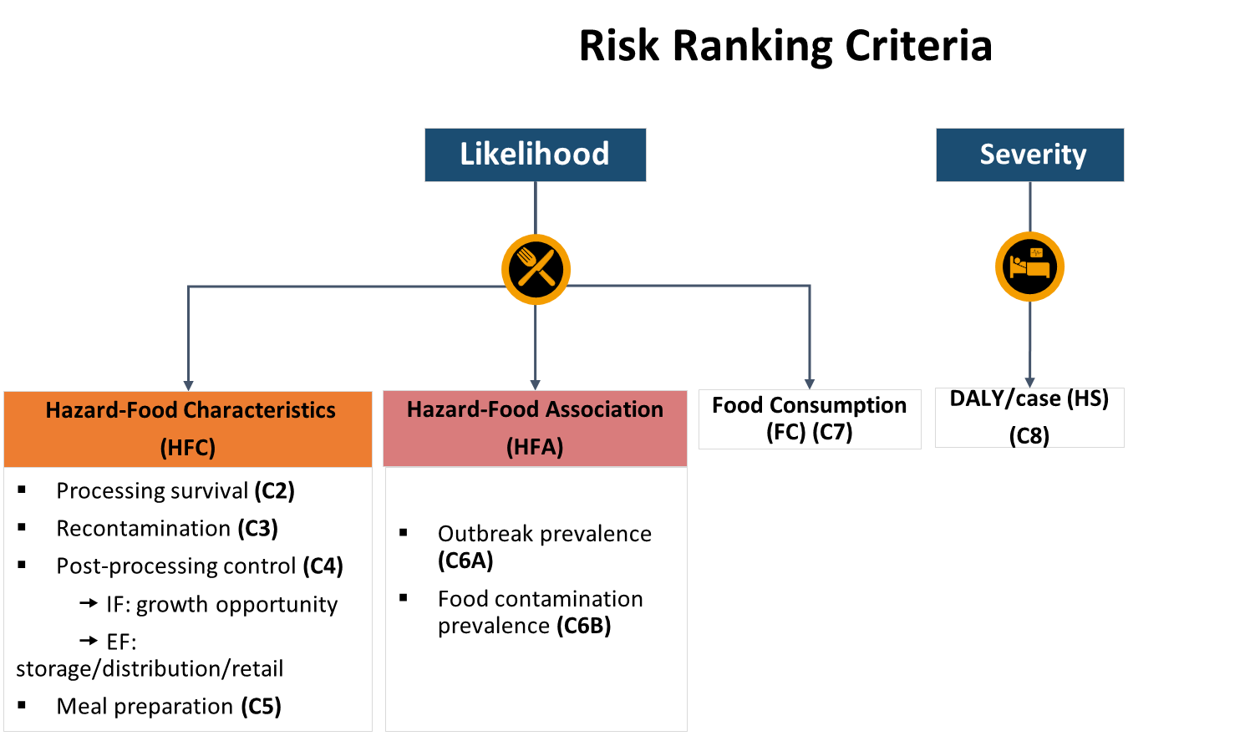







Risk Ranking Steps
S1
Food products selection & relevant hazard-food pairing
S2-S5
Hazard food characteristics of the selected food products
S6
Hazard Food Association of the selected food products
S7
Food consumption
S8
Hazard severity of the identified hazards
Optional
Additional evidence/ Include or exclude criteria
Select risk ranking methods
Aggregation and display ranking results

Slide 13


Risk Ranking Steps
Risk Ranking Criteria
S1
Food products selection & relevant hazard-food pairing
Likelihood
Severity
S2-S5
Hazard food characteristics of the selected food products
S6
Hazard Food Association of the selected food products
S7
Food consumption
Hazard-Food Characteristics
(HFC)
Hazard-Food Association
(HFA)
Food Consumption (FC) (C7)
DALY/case (HS)
(C8)
S8
Hazard severity of the identified hazards
Processing survival (C2)
Recontamination (C3)
Post-processing control (C4)
🠚 IF: growth opportunity
🠚 EF: storage/distribution/retail
Meal preparation (C5)
Outbreak prevalence (C6A)
Food contamination prevalence (C6B)
Optional
Additional evidence/ Include or exclude criteria
Select risk ranking methods
Aggregation and display ranking results

Slide 14
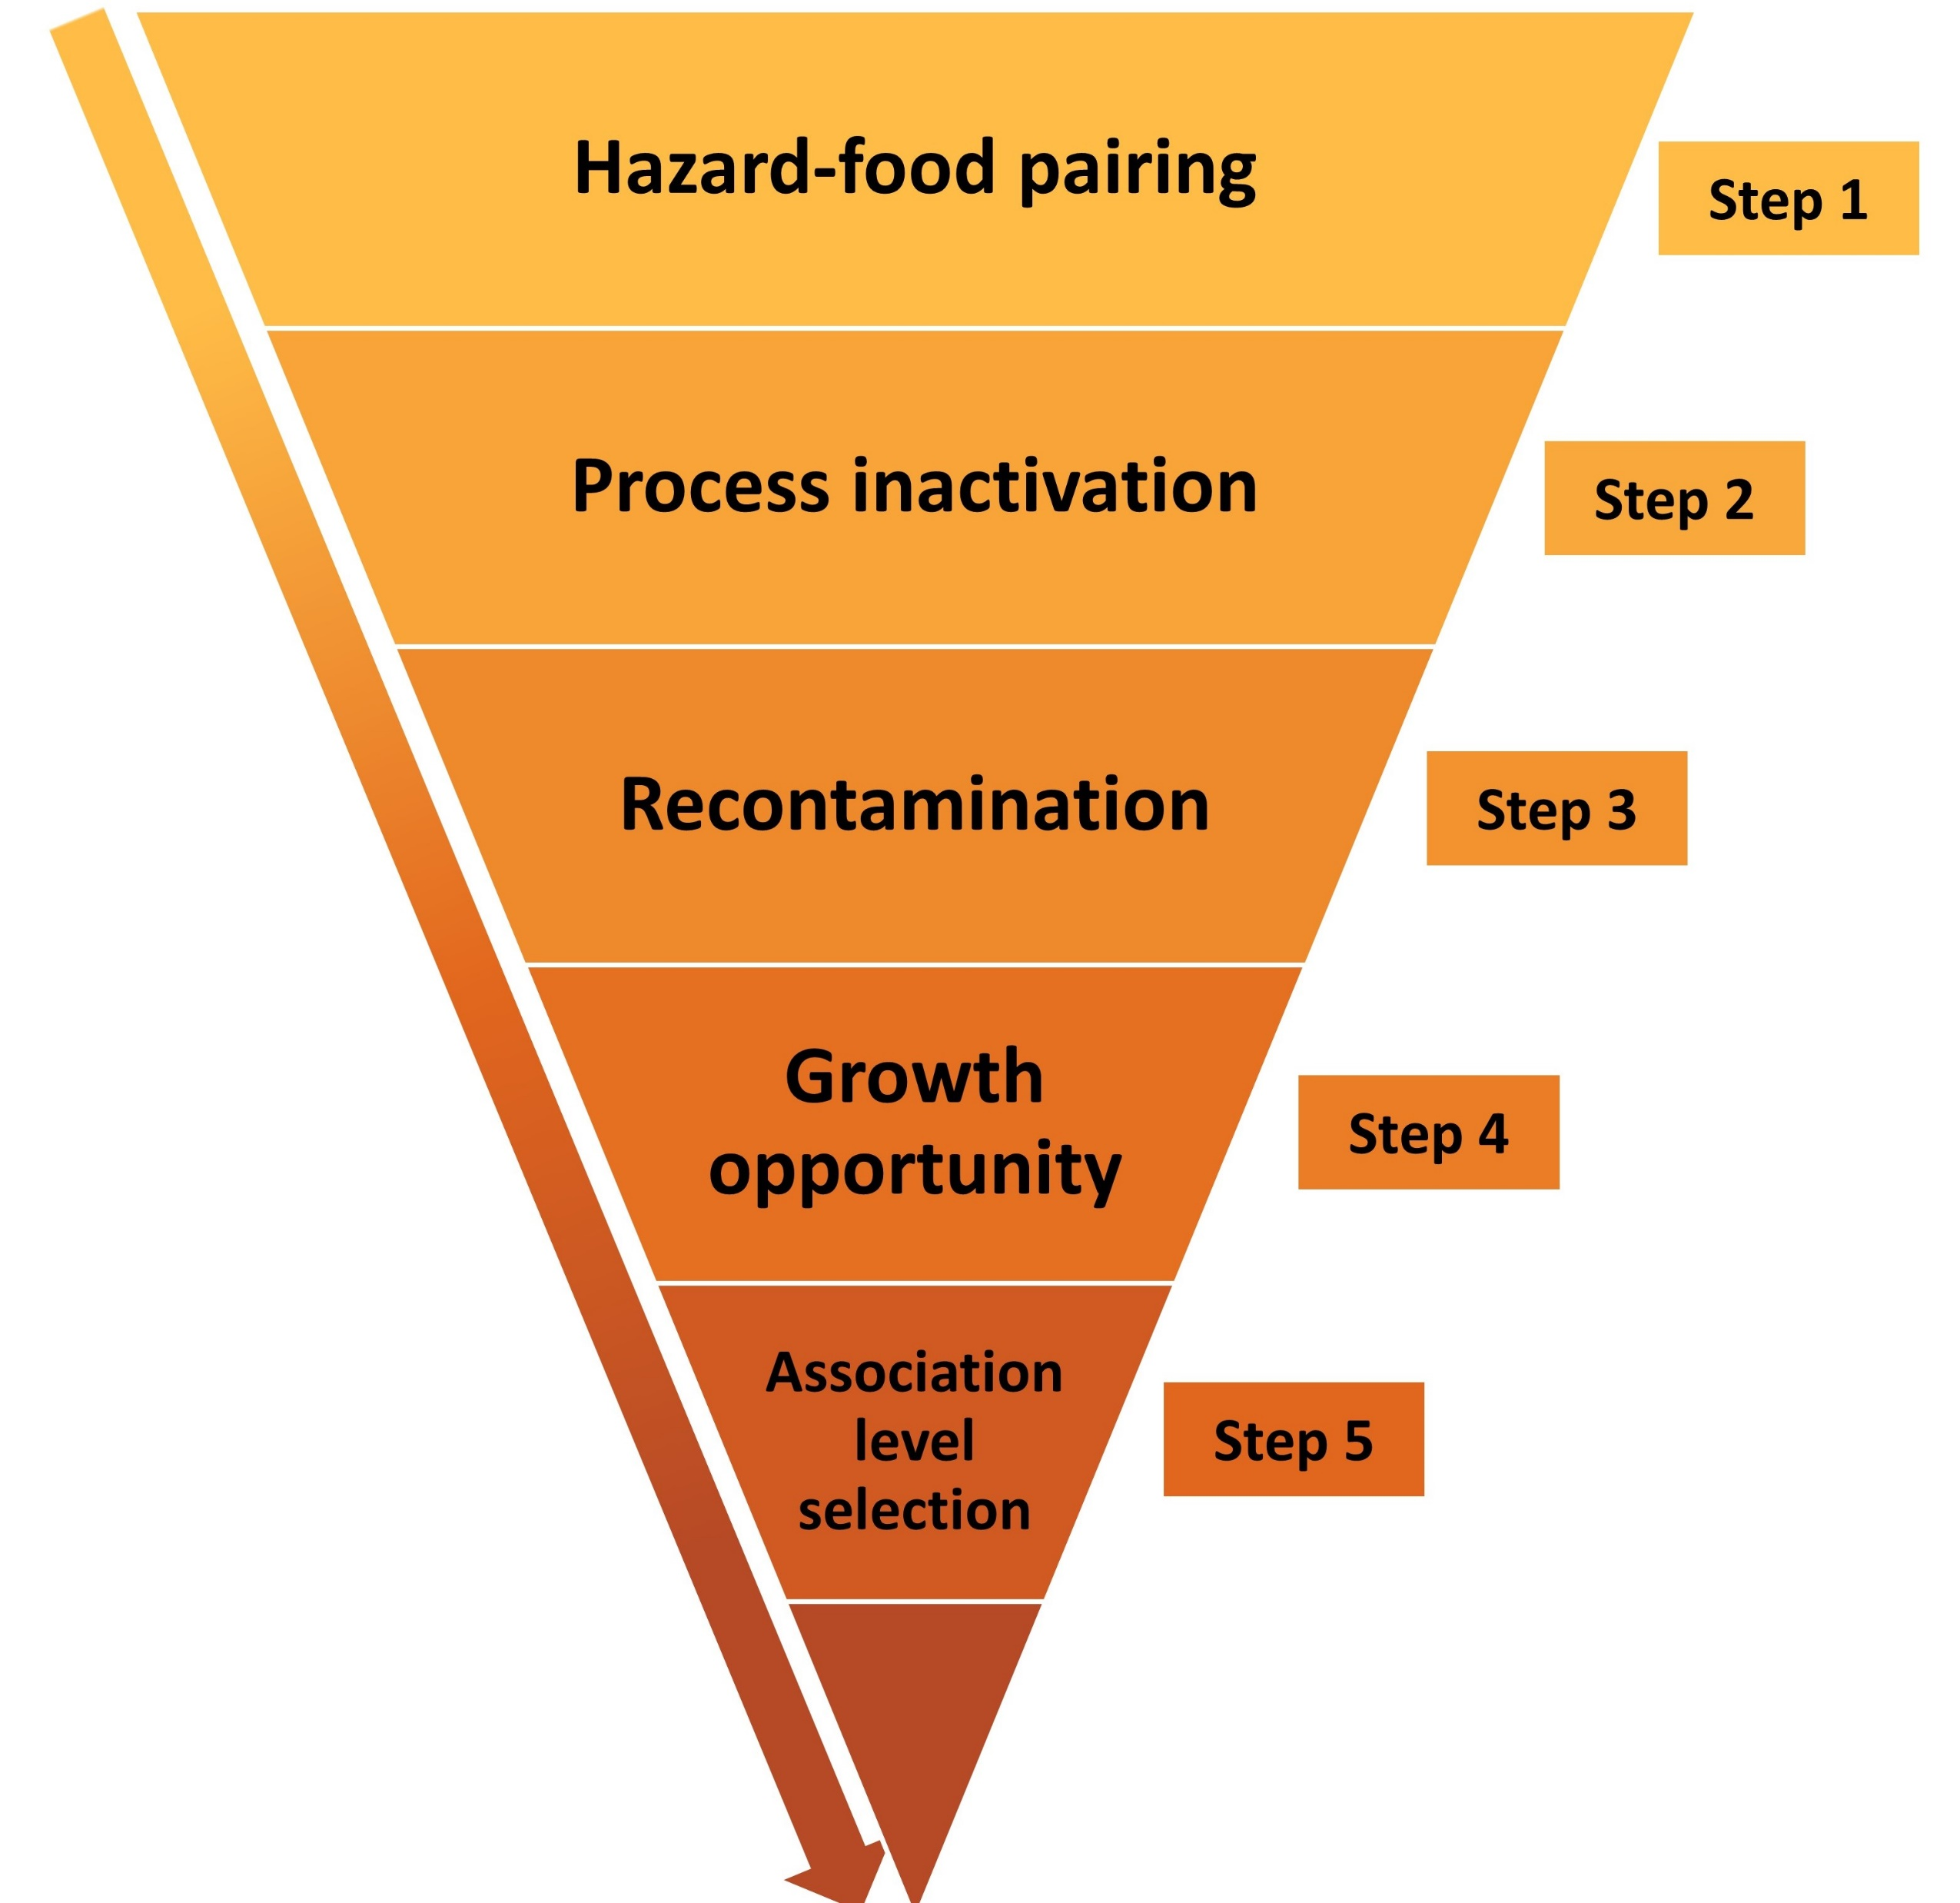
C1
Food products selection & relevant hazard-food pairing
S2-S5
Hazard food characteristics of the selected food products
S6
Hazard Food Association of the selected food products
S7
Food consumption
S8
Hazard severity of the identified hazards
Optional
Additional evidence/ Include or exclude criteria
Select risk ranking methods
Aggregation and display ranking results

Slide 15
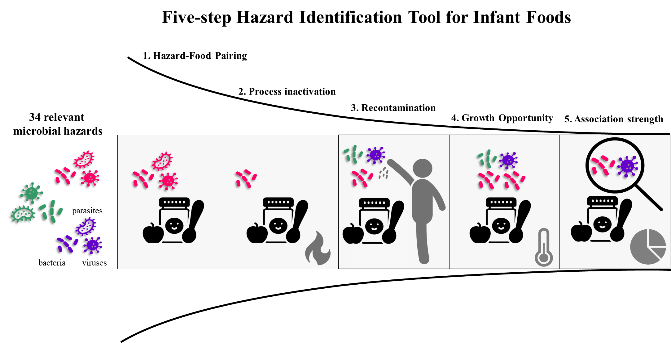


Slide 16
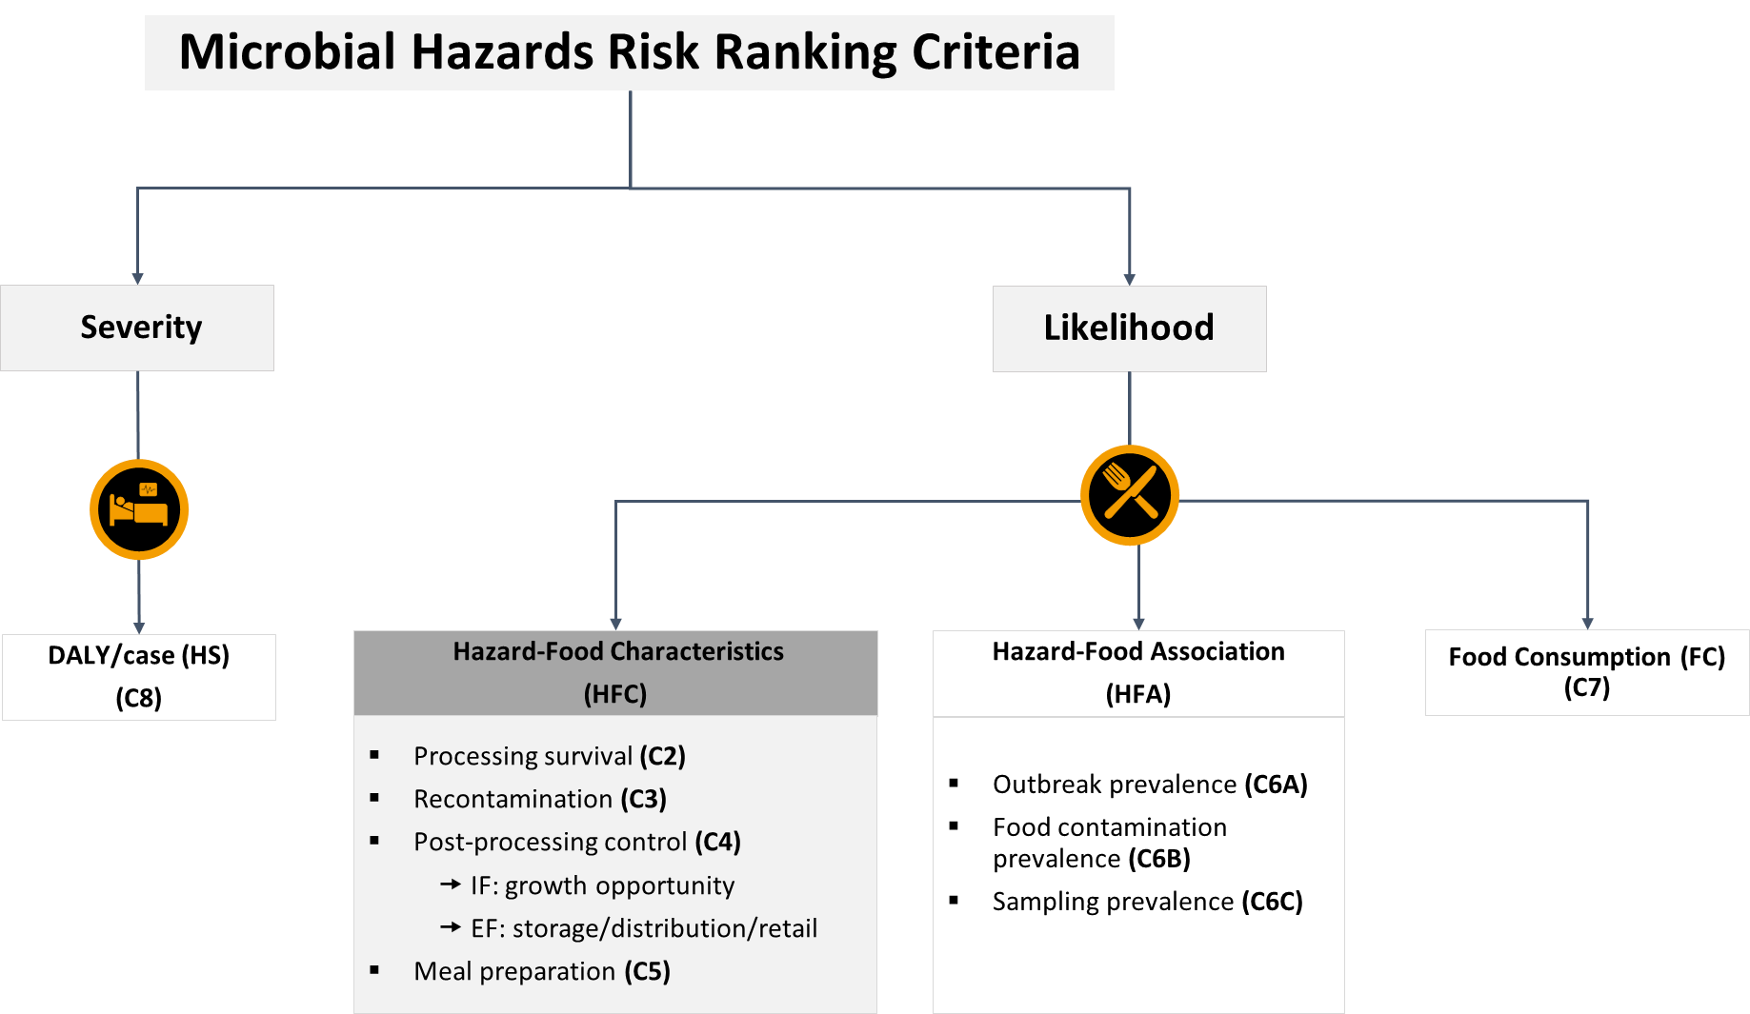
C = criteria
Same number corresponding to the same step now
C2 = Step 2
C3 = Step 3 = recontamination etc.
Total risk = [C2+C3]*C4*C5*C6*C7*C8
If food composition = high fat AND dry product
C2 > Take the highest value
If more than one recontamination category is selected, then
C3 recontamination= C3a + C3b + C3n...

Slide 17
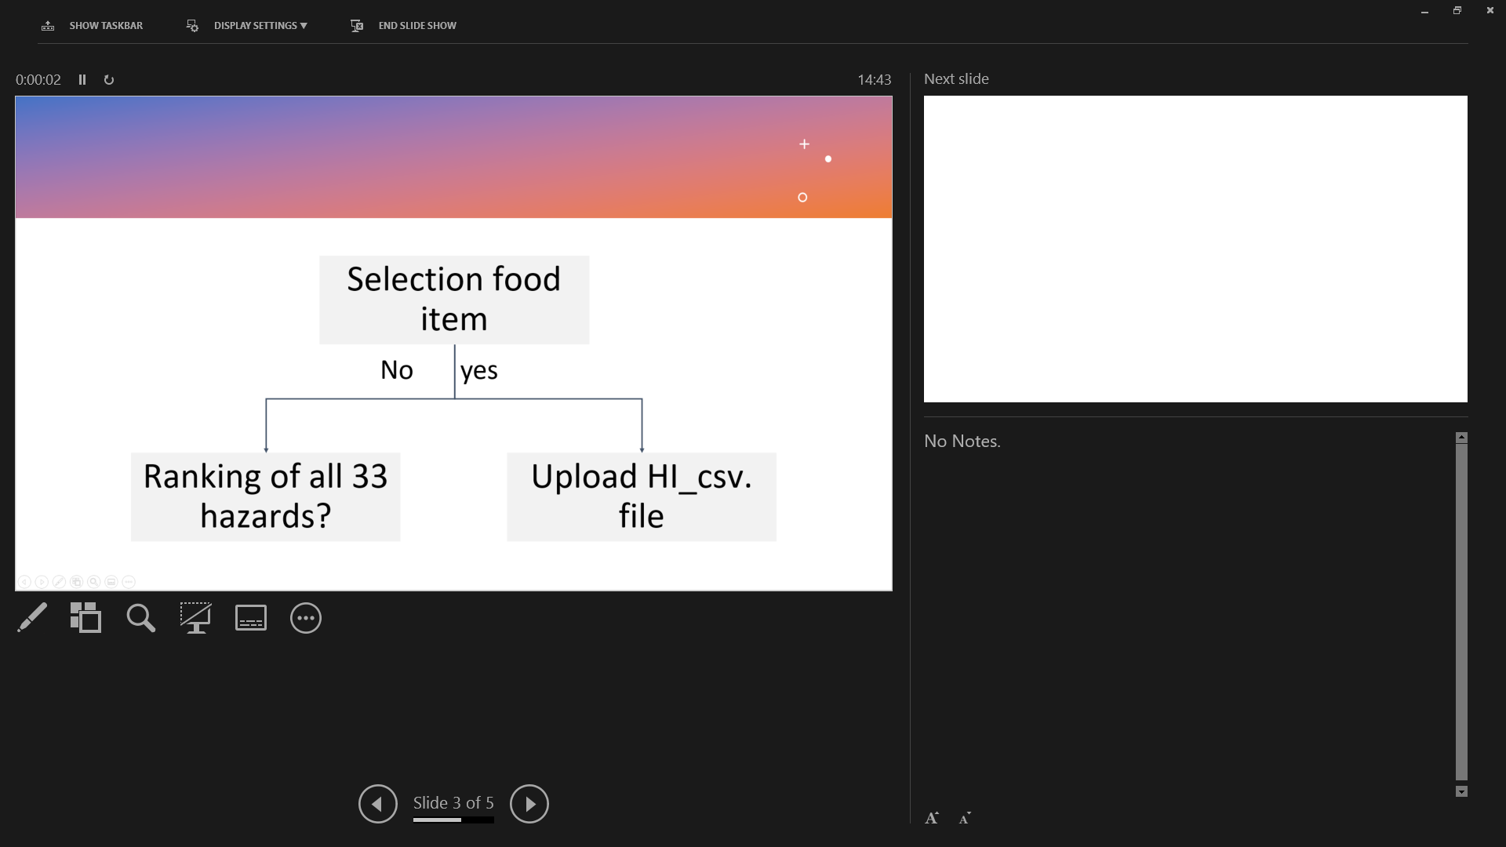
User input and default data in Mira DSS
User’s input
Default data
Parameter | Criteria
Food | Composition: pH; a_{w;} fat content
Factory | S2 Processing techniques S3 Recontamination
Distribution | S4 Storage, distribution and retail conditions S5 Meal preparation
Parameter | Criteria
S6 Prevalence Outbreak Contamination | Default value is automatically added into the calculation
S7 Food consumption
S8 Severity

Slide 18
Food parameter: Select food item
User’s input
Mira
Selection food item
Selection food item
shows hierarchy & code on FoodEx2 next to food item
Ranking of all 33 hazards?
Ranking of all 33 hazards?
No
yes
No
yes
Default way
Upload HI_csv. file
No action is needed
Upload HI_csv. file
No action is needed
Provide link to MiID
https://foodmicrobiologywur.shinyapps.io/Microbial_hazards_ID/

Slide 19
Food parameter: select food composition
User’s input
Mira
Food composition
Food composition
Factors | Tick relevant
High fat | □ yes
Low Aw (0.5-0.9) | □ yes
Dry product (aw < 0.5) | □ yes
pH < 4.5 | □ yes
4.5 < pH < 4.8 | □ yes
pH > 10 | □ yes
Neutral | □ yes
This step influences the inactivation efficacy of the selected processing techniques in the next input
Check processing techniques of factory parameter
Take the corresponding value

Slide 20
Decision tree
Risk value | Score
1E-20 | 1
1E-18 | 1
1E-12 | 1
1E-10 | 2
1E-8 | 2
1E-6 | 2
1E-5 | 2
1E-4 | 3
1E-3 | 3
1E-1 | 4
1 | 4
Processing inactivation effect
Select the processing techniques
Table 1
Thermal
None
High risk
Hazard group | No inactivation
Vegetative bacteria | 1
Virus | 1
Vegetative parasites | 1
Parasite cysts | 1
Heat-resistant virus | 1
Bacterial spores | 1
Bacterial toxin | 1
HPP
Pasteurize
Table 1
PCD
Boil
Select food composition
RF
Sterilize
Table 2
Dry food
High fat
No
Hazard group | Pasteurization | Boiling | Sterilization
Vegetative bacteria | 1E-6 | 1E-10 | 1E-20
Virus | 1E-6 | 1E-10 | 1E-20
Vegetative parasites | 1E-6 | 1E-10 | 1E-20
Parasite cysts | 1E-05 | 1E-10 | 1E-20
Heat-resistant virus | 1E-03 | 1E-10 | 1E-20
Bacterial spores | 1 | 1E-03 | 1E-12
Bacterial toxin | 1 | 1E-03 | 1E-12
Low risk
*exception rule
low risk for Campylobacter in dry foods
Table 2
yes
Medium risk
Table 3
Table 3
Hazard group | Pasteurization | Boiling | Sterilization
Vegetative bacteria | 1E-4 | 1E-8 | 1E-18
Virus | 1E-4 | 1E-8 | 1E-18
Vegetative parasites | 1E-4 | 1E-8 | 1E-18
Parasite cysts | 1E-3 | 1E-8 | 1E-18
Heat-resistant virus | 1E-1 | 1E-8 | 1E-18
Bacterial spores | 1 | 1E-1 | 1E-10
Bacterial toxin | 1 | 1E-1 | 1E-10

Slide 21
Factory parameter: processing techniques
User’s input
Mira
Techniques
Techniques + food composition
Thermal inactivation
Step 2_PE: relevant values in column H, I, or J is used. Display information on columns K &L based on the factory parameter selection
Factors | Tick relevant
High fat | □ yes
Low Aw (0.5-0.9) | □ yes
Dry product (aw < 0.5) | □ yes
pH < 4.5 | □ yes
4.5 < pH < 4.8 | □ yes
pH > 10 | □ yes
Neutral | □ yes
Pasteurizaiton
Boiling
Sterilization
When more than 1 factor is relevant, select the highest value

Slide 22
Default | Wet neutral product | Column H
Factors | Tick relevant | Data column
High fat | □ yes | Column I, display column K
Low Aw (0.5-0.9) | □ yes | Column J, display column L
Dry product (aw < 0.5) | □ yes | Column J, display column L
Acidity | Tick relevant | Data column
pH < 4.5 | □ yes
4.5 < pH < 4.8 | □ yes
pH > 10 | □ yes
Neutral | □ yes | Column H
Problem:
e.g., high fat AND dry;
Addition: has no meaning
Multiplication: make the value smaller which does not make sense
Solution:
When more than 1 factor is relevant, select the highest value

Slide 23
Factory parameter: Recontamination
User’s input
Mira
Sources | Tick relevant
Aseptic processing | □ yes
Wet environment | □ yes
Dry environment | □ yes
Addition of dry herbs or spices | □ yes
Addition of dry vitamins | □ yes
Addition of other dry ingredients | □ yes
Human cross-contamination | □ yes
Sources | Tick relevant
Aseptic processing | □ yes
Wet environment | □ yes
Dry environment | □ yes
Addition of dry herbs or spices | □ yes
Addition of dry vitamins | □ yes
Addition of other dry ingredients | □ yes
Human cross-contamination | □ yes
Step 3_RP: pick the relevant columns and add the numerical values assigned for EF & RF

Slide 24
Decision tree
Category of dry ingredients | Risk of recontamination for relevant hazard
dry spices | 0.5
other dry ingredients | 0.05
dry vitamins | 0.005
Risk value | Score
1E-6 | 1
0.005 | 2
0.05 | 3
0.5 | 4
0 | 0
Recontamination =
R _{environmental factor +} R _{food handling}
Food handling
Yes
No risk and no addition of other ingredients
Processing in close bag?
0
No
*Zero here indicates the entire branch of recontamination will be excluded from RR instead of multiplying with the value zero
Environmental factor
Addition of unprocessed ingredients?
Include possible environmental contaminants?
No
Yes
No
Yes
Dry/Wet?
Human contact with food?
Dry/Wet?
No
Yes
Yes
None/very low risk
Minor risk with MH- dry/wet environment
None/very low risk
Minor risk with MH- humans
Major risk with MH- dry/wet ingredients
*Assuming 50% of 100% of unprocessed ingredients may be contaminated
X
1E-6
0.001
1E-6
0.001
0.005
Category of dry ingredients | Risk of recontamination for relevant hazard
dry spices | 0.5
others | 0.05
dry vitamins | 0.005

Slide 25
Recontamination scenario comparision
 | Assign risk values
Aseptic processing | 0
Environment factor: |  | None | vitamin or human | dry ingre | spices | addition of all dry options | addition of all dry options + human contamination
Wet environment | 1E-6 OR 0.005 | 1.00E-06 | 0.005
Dry environment
Addition of dry herbs or spices | 1E-6 OR 0.005 OR 0.05 or 0.5 | 1.00E-06 | 0.005 | 0.05 | 0.5
Addition of dry vitamins
Addition of other dry ingredients
Human cross-contamination
 | Calculated risk | 1.00E-12 | 5.00E-09 | 5.00E-08 | 5.00E-07 | 1.25E-10 | 6.25E-13
 |  |  |  |  |  | 3.34E-03 | 3.62E-03 | root function
Problem:
Selection of more options for recontamination category ➔ lower value due to multiplication
Solution:
Replace with addition, and it reflects more to the reality

Slide 26
Recontamination scenario comparision
 | Assign risk values
Aseptic processing | 0
Environment factor: |  | None | vitamin or human | dry ingre | spices | addition of all dry options | addition of all dry options + human contamination
Wet environment | 1E-6 OR 0.005 | 1.00E-06 | 0.005
Dry environment
Addition of dry herbs or spices | 1E-6 OR 0.005 OR 0.05 or 0.5 | 1.00E-06 | 0.005 | 0.05 | 0.5
Addition of dry vitamins
Addition of other dry ingredients
Human cross-contamination
 | Calculated risk | 1.00E-12 | 5.00E-09 | 5.00E-08 | 5.00E-07 | 1.25E-10 | 6.25E-13
 |  |  |  |  |  | 3.34E-03 | 3.62E-03 | root function
Problem:
Scenario 1: “ 0 “ in the RP category
Scenerio 2: “ 0.005” in the RP category
Final RR: Scenario 1 should be < Scenario 2
But it is the opposite for now.
Solution: addition will solve the problem

Slide 27
Recontamination scenario comparision
 | Assign risk values
Aseptic processing | 0
Environment factor: |  | None | vitamin or human | dry ingre | spices | addition of all dry options | addition of all dry options + human contamination
Wet environment | 1E-6 OR 0.005 | 1.00E-06 | 0.005
Dry environment
Addition of dry herbs or spices | 1E-6 OR 0.005 OR 0.05 or 0.5 | 1.00E-06 | 0.005 | 0.05 | 0.5
Addition of dry vitamins
Addition of other dry ingredients
Human cross-contamination
 | Calculated risk | 2.00E-06 | 5.00E-03 | 5.00E-02 | 5.00E-01 | 5.55E-01 | 5.60E-01
Scenario 1: “ 0 “ in the RP category
Scenerio 2: “ 0.005” in the RP category
Mutiplication:
Scenario 1: “0”* 5
Scenario 2: 0.005 * 5
Addition:
Scenario 1: 0+5 = 5
Scenario 2: 0.005+5 = 5.0005

Slide 28
Distribution parameter – storage/distribute/retail
User’s input
Mira
Storage/distribution/retail | Tick relevant
Room temperature | □ yes
Refrigeration | □ yes
Frozen | □ yes
Potential temperature abuse | □ yes
Storage/distribution/retail | Tick relevant | Food composition filled by user | Cardinal parameter
Room temperature | □ yes | Take data in food parameter | Compare with cardinal parameter in Supplementary Table X, & take the estimated likelihood in step 4_ PPC2
Refrigeration | □ yes
Frozen | □ yes
Potential temperature abuse | □ yes

Slide 29
Decision tree
Risk value | Score
1E-6 | 1
1E-3 | 2
1 | 3
Post-processing control
Growth Opportunity
No
Hazard needs growth in food to cause illness?
yes
Food characteristic ?
pH <4.5 or >4.5
Dry/half dry/wet
Food characteristics support hazard growth?
No
*Only yes/no growth in food characteristics is taken into consideration, with exceptions for some strains that can otherwise grow in the conditions they cannot grow are
are not taken into consideration
yes
Storage/distribution/retailing conditions
RT
Cold
1-4°C
Freeze
0°C
Potential temperature abuse?
High risk
medium risk
low risk
1
1.00E-03
1.00E-06

Slide 30
Distribution parameter – Meal preparation
User’s input
Mira
Step 5_MP: pick the value in the relevant columns E, F or G
Meal preparation | Tick relevant
Ready to eat | □ yes
Ready to heat <70°C | □ yes
Ready to cook > 70°C | □ yes
Hazard group | RTE | RTH <70°C | RTC >70°C
Vegetative bacteria | 1 | 1E-2 | 1E-4
Virus | 1 | 1E-2 | 1E-4
Vegetative parasites | 1 | 1E-2 | 1E-4
Parasite cysts | 1 | 1E-1 | 1E-03
Heat-resistant virus | 1 | 1 | 1E-02
Bacterial spores | 1 | 1 | 1
Bacterial toxin | 1 | 1 | 1

Slide 31
Decision tree
Risk value | Score
1E-4 | 1
1E-3 | 1
1E-2 | 2
1E-1 | 3
1 | 4
Effect of meal preparation
Further cooking/prep process involved?
Ready to eat foods
Thermal Cooking > 70°C
High risk
Medium risk
low risk
Table 4
1
Table 4
Table 4
Hazard group | Cooking <70C | Cooking >70C
Vegetative bacteria | 1E-2 | 1E-4
Virus | 1E-2 | 1E-4
Vegetative parasites | 1E-2 | 1E-4
Parasite cysts | 1E-1 | 1E-03
Heat-resistant virus | 1 | 1E-02
Bacterial spores | 1 | 1
Bacterial toxin | 1 | 1
* Meal preparation ELIMINATES no hazards

Slide 32
Prevalence and Severity data
User’s input
Mira
Based on user’s input in step 1, display the respective data column in Step 6_HFA4th root, Step 7_FC and Step8_HS values
Parameter | Criteria
Food | item Composition Acidity
Show total ranking of results in a Table
Show total ranking of results in a plot

Slide 33
Decision tree
Hazard Prevalence
Food Consumption
Consumption % by Infants/toddlers in EU ?
Contamination alerts
(US & EU)
Outbreak
(US & EU)
Sampling
(meta-analysis)
Actual consumption percentage in the population of infants and toddlers up to the age of 3 in EU (%)
NR
Strength of evidence (%)
*Assuming 1/million chance it may be the exception
1E-6
Prevalence percentage | Risk value | Score
NR | 0.000001 | 1
< 1% | <0.01 | 2
1-10% | 0.011-0.1 | 3
10.1 - 40% | 0.101 - 0.4 | 4
> 40% | > 0.4 | 5
Consumption percentage | Risk value | Score
NR | 0.000001 | 1
< 1% | <0.01 | 2
1-10% | 0.011-0.1 | 3
10.1 - 40% | 0.101- 0.4 | 4
> 40% | > 0.4 | 5

Slide 34
Decision tree
Risk value (DALY/case) | Score
< 0.05 | 1
0.05-0.5 | 2
0.51-5 | 3
> 5 | 4
Hazard severity
DALY reported?
DALY/case <0.05
Low impact hazard
Low-risk and usually self-limiting
DALY/case = 0.05- 0.5
Minor impact hazard
Minor risk and may require medical treatment
Other data available for calculation?
DALY/case = 0.51-5
Severe impact hazard
Medium risk and mainly require medical treatment
Assumption based on closely-related species that have similar sequelae
High risk and causes severe illness/death to victims
DALY/case > 5
Critical impact hazard

Slide 35




Microbial Hazards Risk Ranking DSS Procedures
Step 1
Food products selection & relevant hazard-food pairing
User input
Step 2 - 6
Hazard food characteristics of the selected food products
Step 7
Hazard Food Association of the selected food products
Step 8
Food consumption
Step 9
Hazard severity of the identified hazards
Step 10
Include or exclude criteria
User optional selection
Step 11
Select risk ranking methods
Aggregation and display ranking results

Slide 36
PAper

Slide 37
Microbial Hazards Risk Ranking Criteria
Severity
Likelihood
DALY/case (HS)
(C8)
Hazard-Food Characteristics
(HFC)
Hazard-Food Association
(HFA)
Food Consumption (FC) (C7)
Processing survival (C2)
Recontamination (C3)
Post-processing control (C4)
🠚 IF: growth opportunity
🠚 EF: storage/distribution/retail
Meal preparation (C5)
Outbreak prevalence (C6A)
Food contamination prevalence (C6B)
Sampling prevalence (C6C)

Slide 38
Criteria | Description | Parameter
1 | Food item | Food
 | Food composition
2 | Processing survival | Factory
3 | Recontamination
4 | PPE: growth opportunity | Distribution
 | PPE: storage, distribution, and retail
5 | Meal preparation
6 | Outbreak | Prevalence
 | Food contamination
 | Sampling
7 | Food consumption of infants and toddlers | Consumption
8 | DALY/case per hazard | Severity
Optional | Include hazard with no/low evidence | Others

Slide 39
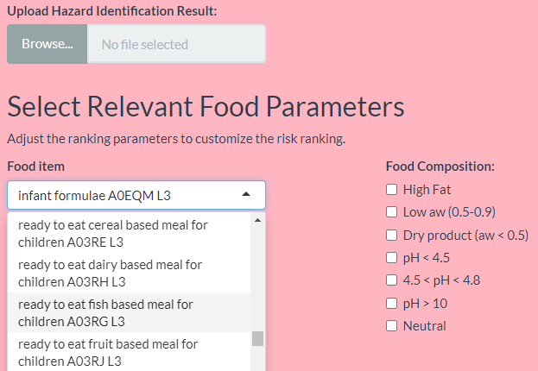

Slide 40
Rank | Genus | Species | Final RR_MiID_Mira | Count
1 | Salmonella | enterica (non-Typhi) | 2.34E-06 | 5
2 | Escherichia | coli (STEC) | 2.29E-07 | 5
3 | Cronobacter | spp. | 1.65E-07 | 3
4 | Escherichia | coli (non-STEC) | 3.75E-10 | 3
5 | Cryptosporidium | spp. | 3.15E-12 | 3
6 | Bacillus | cereus | 3.19E-14 | 5
7 | Staphylococcus | aureus | 1.11E-15 | 5
Rank | Genus | Species | Final RR_MiID_Mira
1 | Salmonella | enterica (non-Typhi) | 2.34E-06
2 | Escherichia | coli (STEC) | 2.29E-07
3 | Cronobacter | spp. | 1.65E-07
4 | Escherichia | coli (non-STEC) | 3.75E-10
5 | Clostridium | botulinum | 1.36E-11
6 | Cryptosporidium | spp. | 3.15E-12
7 | Norovirus |  | 4.02E-13
8 | Bacillus | cereus | 3.19E-14
9 | Staphylococcus | aureus | 1.11E-15
10 | Clostridium | perfringens | 1.11E-15
Product: | Infant formula
Processing parameters | Thermal pasteurization (72°C, 30s)
Recontamination Possibility | Dry environment Addition of vitamins and trace elements
Post processing control | pH 6.5, Aw 0.2, transport at RT
Meal preparation | RTE
HFA | Food category: Milk and dairy products
Food consumption | 0.457
Rank | Genus | Species | Final RR_all
1 | Salmonella | enterica (non-Typhi) | 2.34E-06
2 | Escherichia | coli (STEC) | 2.29E-07
3 | Cronobacter | spp. | 1.65E-07
4 | Shigella | spp. | 6.13E-10
5 | Escherichia | coli (non-STEC) | 3.75E-10
6 | Hepatovirus | A | 9.46E-11
7 | Hepevirus | E | 3.21E-11
8 | Clostridium | botulinum | 1.36E-11
9 | Fasciola | spp. | 6.88E-12
10 | Echinococcus | multilocularis | 5.52E-12
Rank | Genus | Species | Final RR_all | Count
1 | Salmonella | enterica (non-Typhi) | 2.34E-06 | 5
2 | Escherichia | coli (STEC) | 2.29E-07 | 5
3 | Cronobacter | spp. | 1.65E-07 | 3
4 | Escherichia | coli (non-STEC) | 3.75E-10 | 3
5 | Cryptosporidium | spp. | 3.15E-12 | 3
6 | Campylobacter | spp. | 2.15E-12 | 3
7 | Brucella | spp. | 3.80E-13 | 3
8 | Bacillus | cereus | 3.19E-14 | 5
9 | Listeria | monocytogenes | 7.88E-15 | 5
10 | Staphylococcus | aureus | 1.11E-15 | 5

Slide 42
Product: | Fruit puree
Processing parameters | Thermal boiling (95°C, 3 min)
Recontamination Possibility | (no environment contaminant) Addition of vitamins and trace elements
Post processing control | pH 3.8, Aw 0.99, transport at RT
Meal preparation | RTE
HFA | Food category: Food of non-animal origin_fruits and vegetables
Food consumption | 0.457

Slide 43
Product: | Fresh fruit
Processing parameters | None
Recontamination Possibility | Human handling Spraying of water vapor
Post processing control | pH 4.2, Aw = 0.98 Tranported 4°C, potential temperature abuse
Meal preparation | None
HFA | RTE
Food consumption | 1

Slide 44
Product: | Simple cereal
Processing parameters | Thermal pasteurization (65°C, 2X 1-3 min)
Recontamination Possibility | (Dry environment contaminant) Addition of vitamins and trace elements
Post processing control | pH 5.5, Aw 0.4, transport at RT
Meal preparation | Cooking < 70°C
HFA | Food category: Food of non-animal origin_cereal and cereal products
Food consumption | 0.457

